Slide 1
Predicting and Modeling Income Stability in Credit Decisions
Austin Leopold, Chris Pento, Rafiq Sitabkhan
Notes:
Aneesh Varma - Aire CEO

Slide 2
Content Outline
Credit Lending Industry
Aire (Pulse by Aire)
Regulatory Guidelines → Business Problem
Modeling Income Stability
Future Improvements

Slide 3
Credit Lending Industry
Notes:
Rafiq

Slide 4
Paradigm Shift
Previous credit decision process centered around soft information
Personal relationships in small towns
Transition to hard information centered process
Credit score
Big data
Economies of scale benefit for lenders
Large focus on data acquisition and use
AI provides many benefits but also risks
Notes:
Credit process fundamental shift
Soft information centered with personal relationships and personal characteristics
personally knowing the applicant
Very expensive since physical locations and physical labor from loan officers
Switch to hard information centered
Much cheaper for lenders
Credit score is standard
Access to big data is enormous and this plays into decision making for lenders
Hard information is quantitative and easy to store
Switch from soft info to hard has impact the industry immensely
Switch from local and personal to nationally and impersonal
Tremendous economies of scale for lenders compared to soft information centered industry
Data acquisition has played an essential role in this new industry
Models need large datasets to train so they work for a wide variety of people and risk profiles
Risk that machine learning and models will not conform to regulatory requirements so sensitive data such as age or race is removed from datasets
Still further risks that models will be able to predict race for example and act discriminatorily so very large focus on removing bias risk

Slide 5
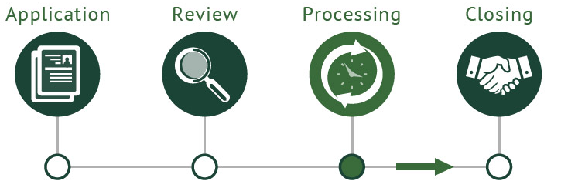
The Credit Decision Process
Customer application to lender
Lender assesses creditworthiness
Applicant risk assessment
Asymmetric information
Lender makes credit decision
Credit extension or rejection of application
Notes:
Current credit decision process originates with individual submitting an application to a lender such as a bank
Lenders use big data and other hard information to assess an applicant risk
Lenders main job is to ensure that their loan is a wise investment
They conduct adequate due diligence to ensure this
Main risk for lenders is that the applicant defaults
However, there is asymmetric information in the lending process: applicants know much more about their financial situation than the lender does
The lender is tasked with using the information available to them to the best of their ability to make a decision
In the end, the lender either extends credit or rejects the application

Slide 6
Aire
(Pulse by Aire)
Notes:
Chris

Slide 7
Aire Overview
Data directly from consumers
Rapid credit insights
Differentiated from traditional credit bureaus
Affordability or Ability to Pay
Notes:
Uses first-party data to provide forward-looking credit insights to lenders in an instant
Consumer-centric
Starch contrast from traditional credit bureaus
Traditional credit bureaus focus on past credit history rather than forward-looking predictions
Affordability or Ability to Pay
(Interview not Survey)

Slide 8
Pulse by Aire
“Pulse from Aire delivers rapid, actionable insight on the current financial situation of your existing customers, fast”
Pulse can help lenders save up to $78 per existing customer
Fully auditable and in compliance with credit lending industry regulations
Notes:
3 pronged approach
Validated Total Income
Project gross income moving forward into future
Non-Discretionary Expenditure
Insight into a consumer’s ability to service additional debt and withstand shocks
Measure of Engagement
Measures the level of interaction of customers

Slide 9
Regulatory Guidelines → Business Problem
Notes:
Austin

Slide 10
Key Regulatory Laws
CARD Act - Ability to pay provision
Truth in Lending Act (TILA)
Regulation Z
Equal Credit Opportunity Act - Bias
Dodd-Frank → CFPB
Notes:
Adding speaker notes - Austin
All of these regulations have certain aspects that affect the credit lending process, with many opening the pathway to the forward looking aspects of an applicant
CARD Act → 2009 (Ability to pay provision)
One of the more complex regulations we had the chance to research
Protects consumers from unfair practices in the lending industry by preventing lenders from targeting vulnerable consumers or making decisions with the knowledge that the person will not be able to make such repayments
ABILITY TO PAY PROVISION: requires card issuers to consider a consumer's ability to make the required payments on the account
Applies to both increases in existing credit line and issuance of new cards
TILA
Subsequent modifications to the CARD Act
Contains requirements to consider repayment ability based on consumer’s income, assets, and current obligations
Issuers must establish reasonable policies and methods for considering one of the following:
the ratio of debt obligations to income
the ratio of debt obligations to assets
the income the consumer will have left after paying debt obligations
Regulation Z
Creates flexibility in reporting income and overall net worth
Credit issuers can consider assets or income that an applicant has as a “reasonable expectation of access”
Can report income of the income of a non-applicant, such as a spouse
Equal Credit Opportunity Act (ECOA)
Implemented by Regulation B
Focused on BIAS
unlawful for any creditor to discriminate against any applicant with respect to any aspect of a credit transaction (1) on the basis of race, color, religion, national origin, sex or marital status, or age (provided the applicant has the capacity to contract);
Spoke to Aneesh about age as this is a very leverageable data component
However, it generates too much bias, for example if you have a 65 year old his income would inherently be more unstable than a 28 year old since the 65 year old is more likely to retire over the next several years.
lenders must have strong procedural safeguards in order to not only protect themselves but also the consumer
Dodd-Frank
Following the 2008 subprime mortgage lending crisis
Creation of the Consumer Financial Protection Bureau
The CFPB was charged with protecting consumers against abuses related to credit cards, mortgages, and other financial products
-
-

Slide 11
Implications on Lending Industry
Ability to Pay
New market generation
Lenders must take into account an applicant’s ability to pay
Bias
Shift into hard data
Must focus on removal of bias decision making by using data properly
FinTech companies arising
Seeking to solve this problem for lenders
Notes:
Adding Speaker notes - Austin
Ability to pay
Space has been opened by those aforementioned regulations which push lenders to analyze the ability to pay of an applicant
BIAS
With the Equal Credit Opportunity Act, lenders must eliminate bias in their predictive modeling while also managing a great amount of data
Must use data properly
In order to build models that perform well across a national market covering a heterogeneous pool of applicants, the acquisition of data becomes paramount.
FINTECH COMPANIES
AIRE - arising to solve this problem for lenders
Costly adhoc interviews → Leaves space for FinTech companies which create a scalable solution
reduce costs and improve credit models significantly for lenders
in addition to helping applicants that are overlooked by existing credit models.

Slide 12
Ability to Pay
<Graphics omitted from public facing slides>
Notes:
4 key requirements in the credit decision process for lenders
Past Credit Behavior
This space controlled by Traditional credit bureaus
Experian, Equifax, Transunion
Affordability, a.k.a ability to pay (new)
Following changing regulatory requirements this space has opened up
Manual solutions (no other unified offerings)
Manual solutions by lenders
Not outsourced
The Work Number by Equifax
The Work Number main outputs are validating an applicants identity, education status, and tax data. It also allows lenders to match an individual with the social security administration, allowing lenders to obtain tax and wage statements, painting a better picture of the historical records of an individual
Pulse by Aire
create modules (a set of statistics and estimates) that give better insights into the future outlook of an applicant
While the work number produces information adjacent to ability to pay, Pulse is the only product directly focusing on creating forward looking projections to advise lenders on how affordable credit is for a given applicant.
Identity
Onfido, LexisNexis, Trulioo, Comply Advantage
Fraud Risk
Custom Bespoke Internal Systems, Cifas, IBM, SAS

Slide 13
Aire Compliance
Pulse by Aire falls within this “ability to pay” sector
Predictive modeling of forward looking data on an applicant
Aire improves lenders regulatory compliance
Aire’s goal
Avoid predatory lending
Eliminate Bias in output
FCRA requires applicant reasoning be public knowledge
Notes:
Adding speaker Notes - Austin
Aire’s Goal: To Deliver fully auditable credit insight for lenders, built specifically to comply with FCRA, ECOA and other consumer protection laws - Aire’s goal

Slide 14
Modeling Income Stability
Notes:
Rafiq

Slide 15
Income Stability
Ability to pay = future income - expenses
Expenses relatively stable → our focus is on modeling income stability
We define income stability as the likelihood that an individual’s future income over the next two years will be greater than 90% of the individual’s current income.
Notes:
This is what we were tasked with. The ASK. Our semester long project and research was focused on understanding this idea and developing a model to predict this
Ability to pay equation
Tie back to Austin’s regulation discussion
Assumption with equation is that expenses remain relatively stable, so our focus is modeling income stability
This is not the case for everyone clearly as expenses can suddenly increase or even decrease
however, it is a general assumption that is sufficient for the general population
In order to model income stability, we have to define it
Say definition
We will discuss later that the 90% is a suggested value and can be customized by lenders to be potentially lower or higher

Slide 16
Approach to model
Initial ideas based on classic machine learning set up: IncomeNextYear_{i,t}=f(X_{i,t} )
Many approaches to this: Matching, regression, etc
Infeasible!
We pivoted in two ways
Clarified question: Predicting probability of income decline (10+% decline)
Different approach: Model that via tree, where subproblems are solvable
Main scenario: loan applicant with 1 job
Let’s look at the model...
Notes:
initial model ideas:
Based on machine learning setup
Income for the next year is based on a function of X (numerous characteristics such as previous salaries, job title, certifications) with relation to i (index of each person) and t (for a given year)
Another idea was to get past income data to better predict future income (too much time to put in that info for interview and not accessible data for us to get)
Many approaches to this such as regression and matching
Overall we realized this was infeasible and moved on
Pivoted:
turning point realization was to predict probability of not stable income (much easier to compute and this got the ball rolling for us)
We decided to show our approach to modeling income stability through a probability tree, where subproblems are solvable
See in next slide
this scenario of an applicant with 1 job covers the majority of users
not privy to salary versus hourly
This is what we model

Slide 17
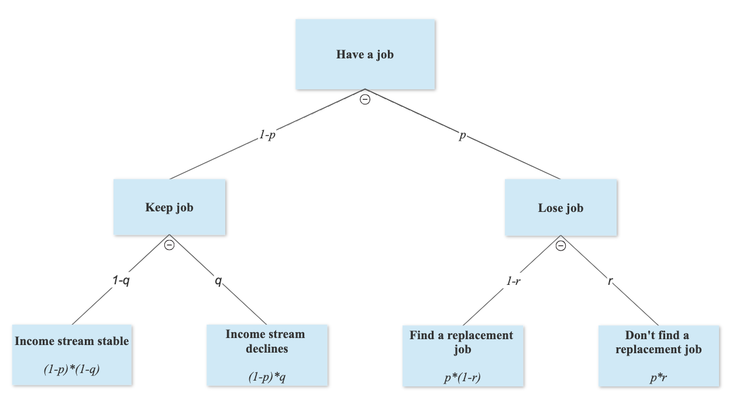
Notes:
Explain that it starters with the assumption that the applicant has a job
We were thinking of ways to model the situation that an applicant does not have a job and applies for a loan
Aneesh informed us that this is a non-issue since if someone does not have a job, they will be rejected almost every time for the most part
This is our probability model laid out in a tree format
I will go variable by variable to highlight their meanings and implications associated with them

Slide 18
Probability an applicant loses their job
Data: current job title and employer data
Information matched to sector to determine sector-level employment conditions
Notes:
“p” is the first variable to understand as it is the first node of the tree
It is the probability an applicant loses their job
Estimate Aire makes themselves before they make the income instability estimate
Data needed for it is current job title and employer data, which is already owned by Aire
Job board data is data from various job websites such as Indeed or LinkedIn that provide information about job postings and salary/ hourly wage data as well
This data is matched to the sector in which an applicant works
Better determine probability of retention probability for a specific sector
For example an actuary versus a semi truck driver have very different retention probabilities and having a sector level prediction allows for this

Slide 19
Probability of income decline at current job
Initial proposal: Assume incomes for a given job do not decline (“q”= 0)
Simplicity
Initial execution is easier
Performs well for a large portion of applicants
Notes:
“q” variable is probability an applicant’s income declines given that they keep their job
Seen in tree
We have the assumption that incomes for a given job do not decline so “q”= 0
this assumption is false but performs well for a large portion of applicants (especially salaried workers)
It is simple and initial execution is easier
The potential for future improvements for this variable would allow for this false assumption to be remedied

Slide 20
Probability that replacement job is not found
Replacement job needs to make at least 90% of previous job’s income
“1-r”: Probability an applicant does find a job with sufficient pay
Prob(NewJob)
Prob(Salary>90%|New Job)
Notes:
“r” variable represents the probability that the applicant does not find a new job with income greater than 90% of their previous job’s income
Assumes job lost so “p”
We propose estimating “1-r” which is calculated for replacement job and sufficient replacement income

Slide 21
Probability that replacement job isn’t found
Prob(NewJob) and Prob(Salary>90%|New Job)
Data: personal information matched to job board data
Distribution of salaries and information on job postings and fillings
Compare number of jobs available with unemployed working age population in an area
Notes:
As mentioned, “r” is based on finding a new job and finding a job with sufficient income (90%)
We gather this data from personal information provided in the interview and matched to job board data
Personal information such as current salary is matched to job board data to better predict on an individual level
Compare applicant’s salary to other similar jobs based on title, company, location, etc.
Also Aire provided
For a given job title and location, the data contains the distribution of salary offers and information on job postings and fillings
This allows us to measure the probability of finding sufficient income given that a new job is found
We can also find the probability of finding a job itself by comparing the number of jobs available in a given area and number of unemployed working age people (BLS data)

Slide 22
Output: Probability of an income decline
{
Applicant keeps job and income stream declines
Applicant loses job and does not find a sufficient replacement job
Y=(1-p)q+pr
{
Notes:
Probability that income is unstable, “Y”
Probability that a user has reached the second (Income stream declines) and fourth (don’t find a replacement job) nodes of the tree
Highlight how it works with tree

Slide 23
Model Implementation
No new data inputs (uses existing Aire ecosystem data)
No changes to Aire UI → Interview completion rate and time will not change
Model run time not significantly affected
Fast run times are crucial in providing data insight to lenders
Notes:
Model can be successfully and efficiently implemented
All data needed for variables are Aire owned data as in we would not need new data for this model
The aire user interface will also not change
No new interview questions
Interview completion rate is very important since banks pay based on completed interviews
No new questions so time and completion rates will remain the same
Model run time not significantly affected
Fast times are crucial for providing data insight to lenders
Speed is money

Slide 24
Model’s Regulatory Compliance
Aire’s regulatory compliance is crucial both for themselves and for their lender clients
Variable compliance:
“p” operates at a sector-level, not an individual level
“q” has the assumption for everyone that incomes of a given job do not fall
“r” is mapped to job board data for location and job-specific labor market conditions
Notes:
As mentioned regulatory compliance is crucial for Aire
Legally bound and offer this service for lenders themselves
”p” operates at a sector level, not individual level where there are protected classes
everyone is assigned the same value (q=0) so no bias
”r” is mapped to high level, not individual data
Does look at individual’s income
Chris will talk more about how individualized our predictions are

Slide 25
Future Improvements
Notes:
Chris/ Austin

Slide 26
Individualized Predictions
Individualized prediction concern
Will the model assign the same income stability to a group of people working the same job in the same city?
Sector-level predictions versus individual predictions
“r” variable is based on applicant’s income
Sufficient individual prediction comes from this

Slide 27
Improving Model Components
Improvements
p
p2
Probability of losing job
Firm size and layoff rates
Probability that current job income declines
(q=0)
q
q2
Income distributions,
BLS occupation-level data,
Employers
Probability that applicant doesn’t find new job with income > 90% of their previous job’s income
r
r2
Average length of time that a job type sits open on a job board before it is filled
Notes:
Chris

Slide 28
More Model Scenarios
Modeling jobless income
Covering spousal income factor
Multiple job scenarios
Gig economy - diversification vs. service sector exposure
Passive income individuals
More sensitive to aggregate macroeconomic conditions
Paltry number of individuals in this category
Notes:
Austin

Slide 29
Extensions to Output
Lenders may use alternate thresholds
85% instead of 90% of current income threshold
Different forecast horizons (6 months, 1 year, or 2 years)
Ability to model remote work
COVID-19 effect
Notes:
Austin

Slide 30
Conclusion
Continuously changing credit industry has allowed for Aire’s industry penetration and positioning
Big data
Ability to pay focus
Our model predicts an applicant’s income stability, in order to better determine ability to pay
Forward-looking
Feasible with little cost
Compliant with regulations
Potential for future improvements
Notes:
Regulation changes resulted in mandate for lenders to consider an applicant’s ability to pay
Aire can help predict this, while also easing regulatory burdens for lenders

Slide 31
Thank you
Questions or comments?

